Slide 1
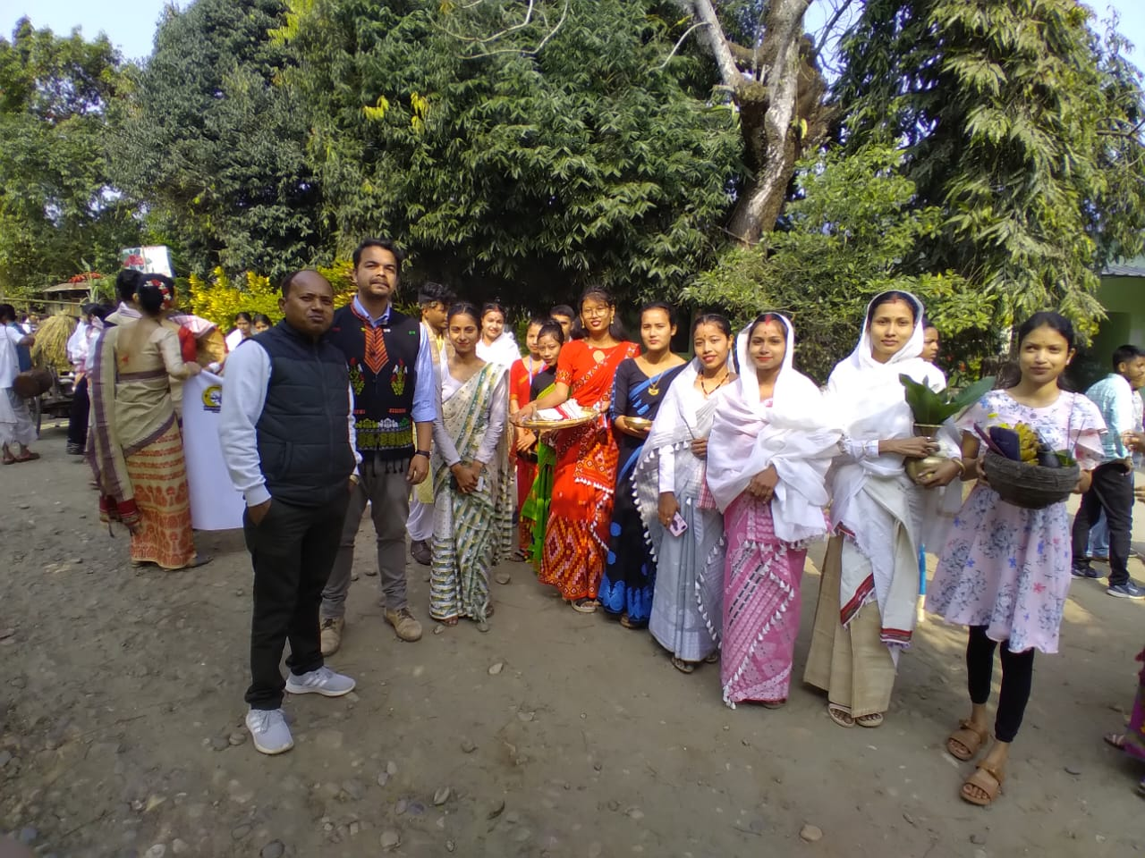
Participating in Cultural rally of Annual College Week 2023 on the theme - showcasing Assamese Marriaage Practices and its associated customs

