Slide 1
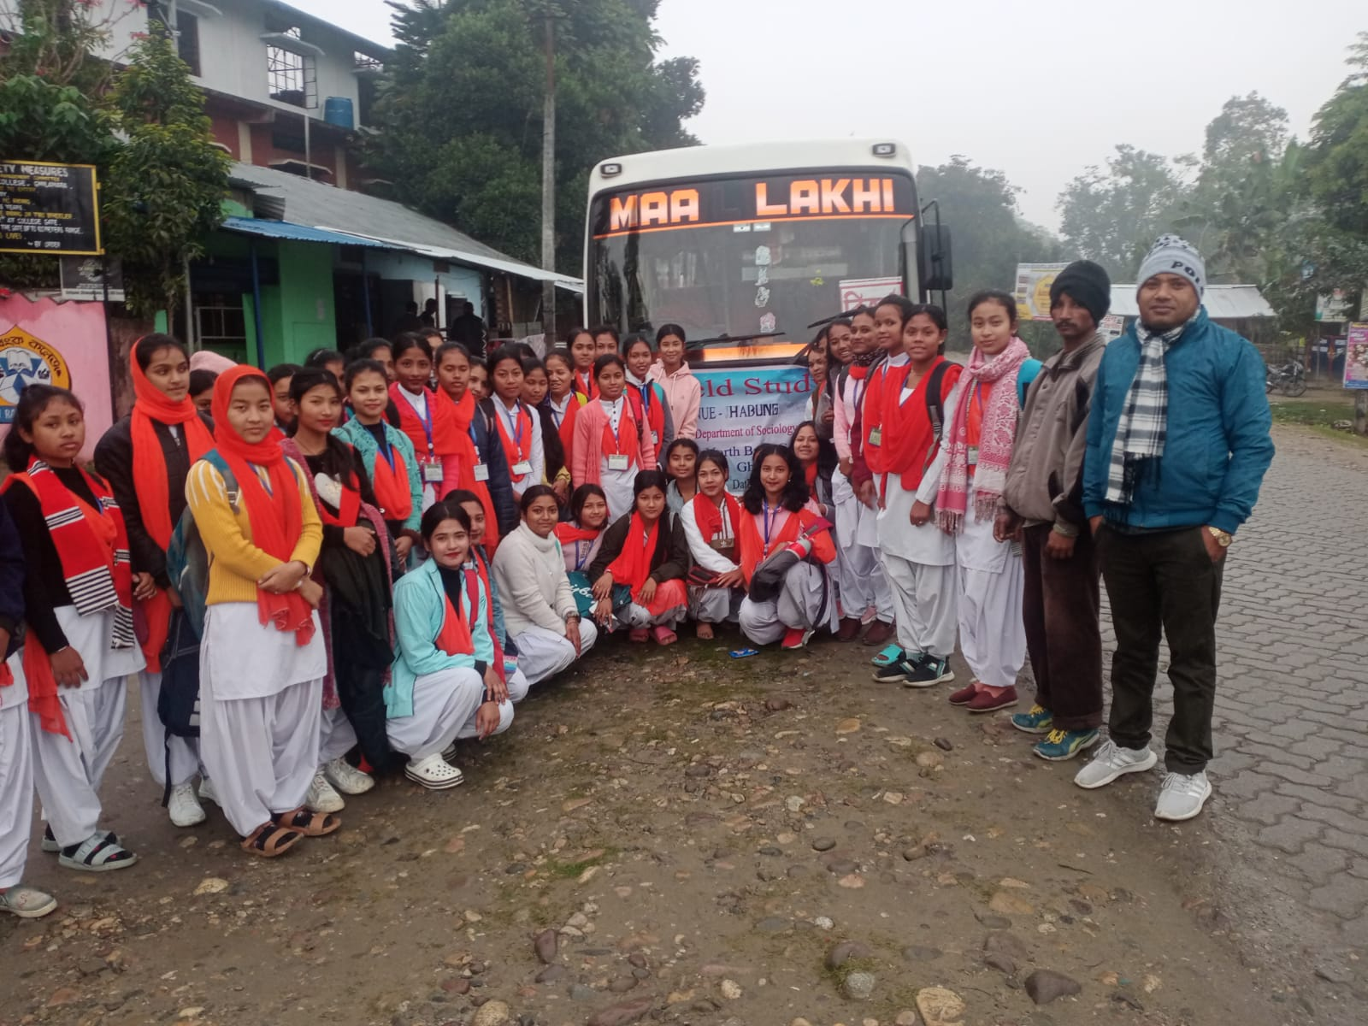
Field visit for Departmental Project work to Historic Second Capital of Ahom Kingdom -Habung 22

