Slide 1
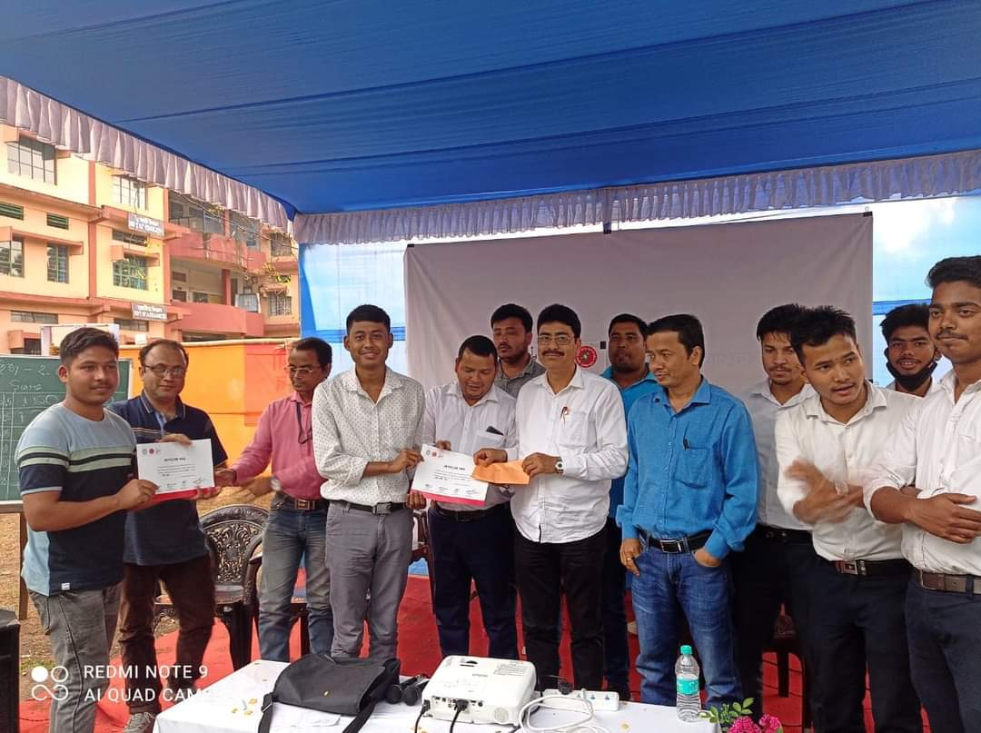
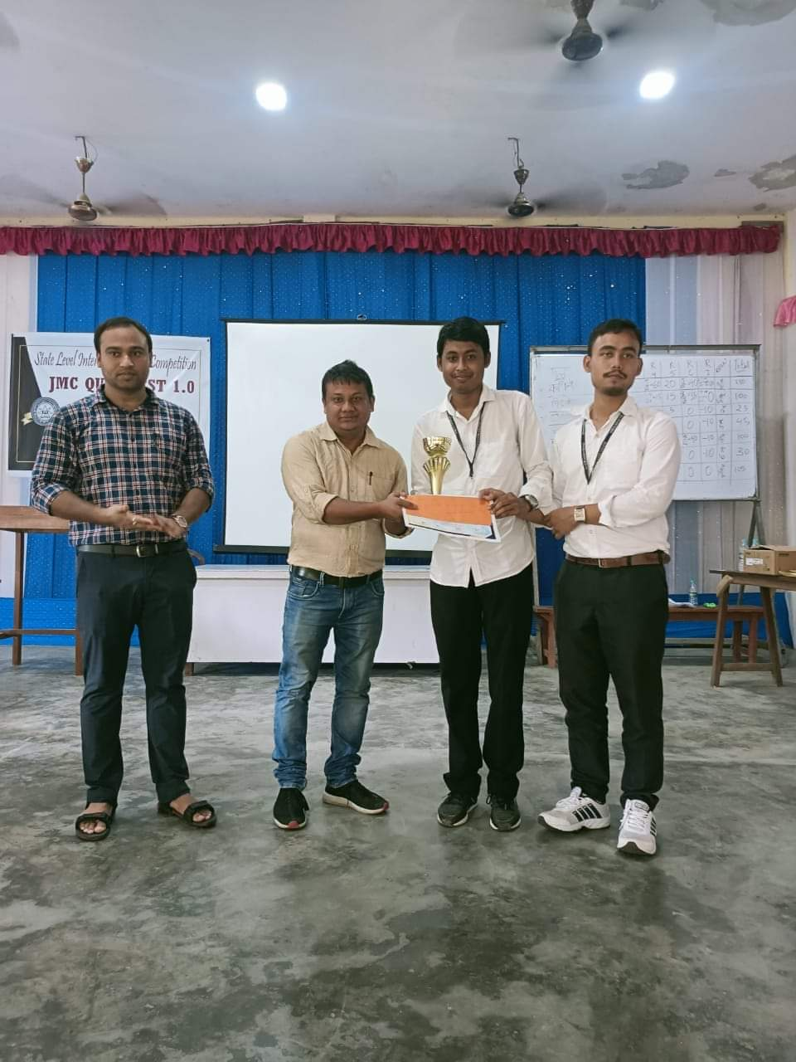
Pranay Pratim Baruah and Rubul Phukan , participated in Inter College Quiz competition, held at Lakhimpur Autonomous college and have won second prize (24. 03. 2022)

