Slide 1
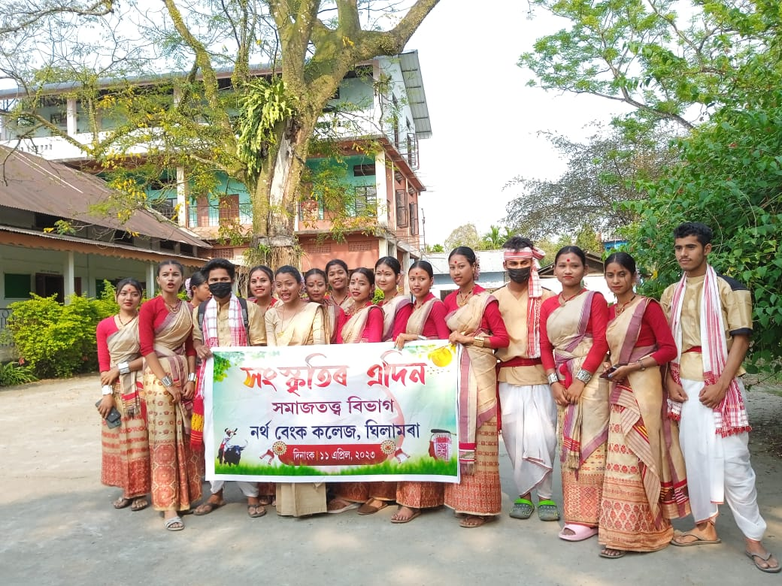
Participation In Cultural Programme At The Event 'Hongskritir Edin'

