Slide 1
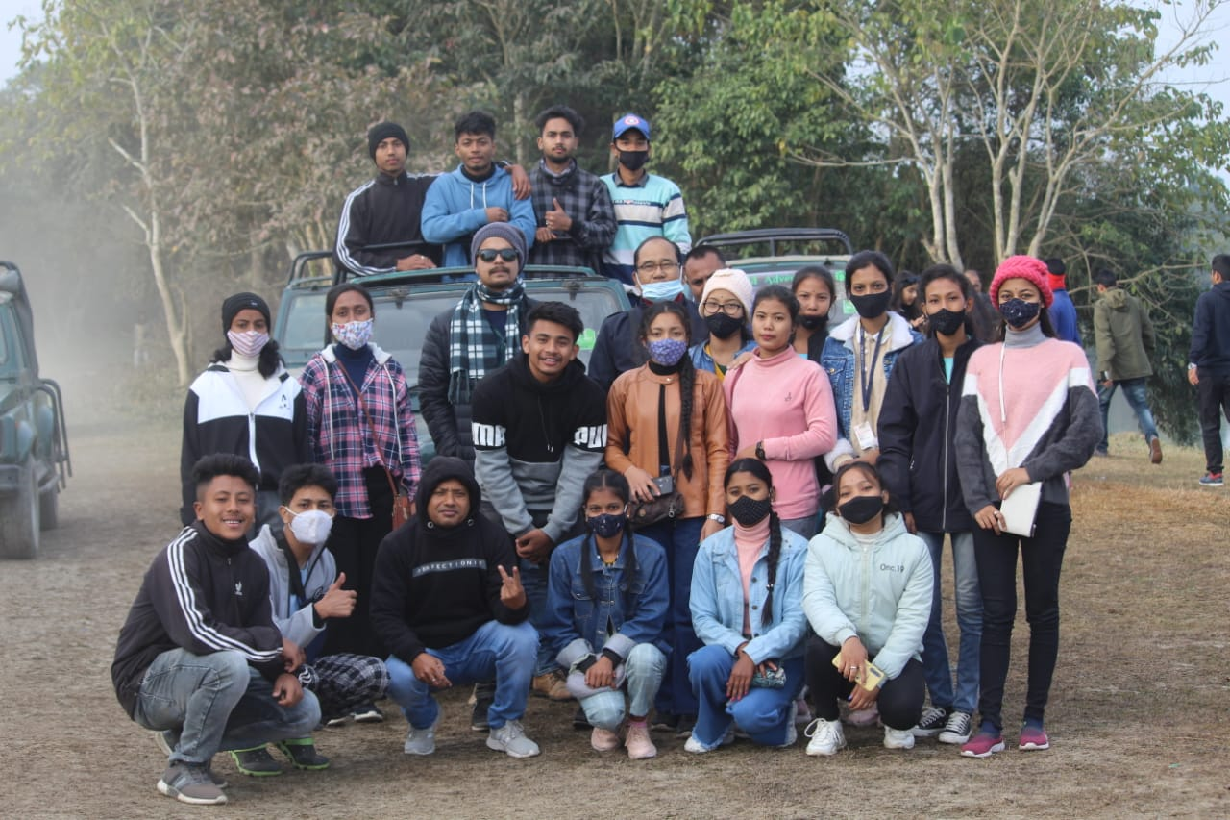
Educational Trip to Kaziranga National Park 2022

