Slide 1
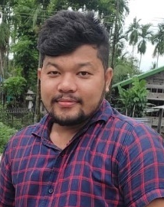
Name: Mahananda Chintey
Passing Year: 2017
Address: Vill: Baliyani
P.O: Ghilamara, Dist.: Lakhimpur, 787053
Email-id: mahanandachintey12@gmail.com
Contact No.: 8471947296
Current Status: Job in Reliance Insurance

