Slide 1
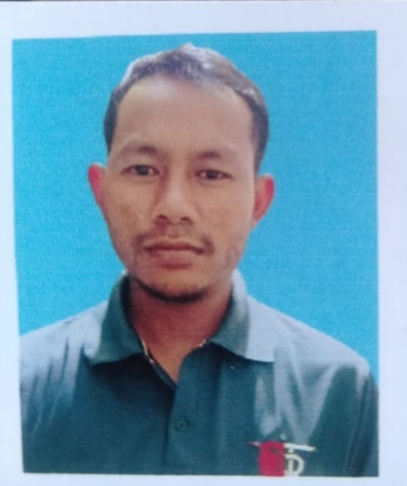
Name: Bhadra Singh Regon
Passing Year: 2019
Address: Vill:
P.O:
Email-id:
Contact No.:
Current Status: Preparing for Govt. Exam

