Slide 1
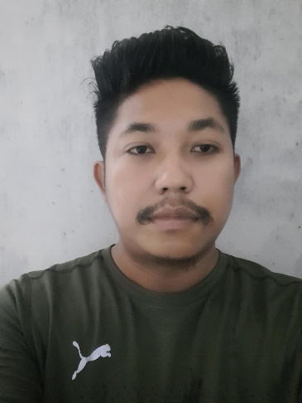
Name: Hira Kr. Kaman
Passing Year: 2019
Address: Vill: Kathalguri
P.O: Gogamukh, Dist.: Lakhimpur
Email-id: hirakaman4@gmail.com
Contact No.: 6000961264
Current Status: Preparing for Govt. Exam

