Slide 1
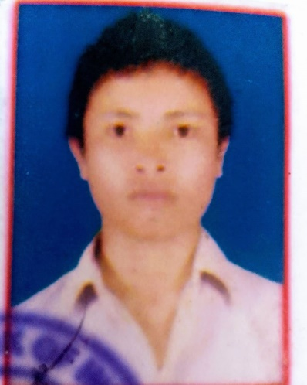
Name: Karuna Doley
Passing Year: 2019
Address: Vill: Namoni Tajik
P.O: Gogamukh, Dist.: Dhemaji, 787034
Email-id: doleykaruna43@gmail.com
Contact No.: 6003392367
Current Status: Preparing for Govt. Exam

