Slide 1
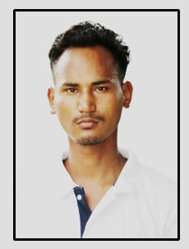
Name: Lakhinath Pegu
Passing Year: 2019
Address: Vill: No. 3 Latak
P.O: Gogamukh, Dist.: Dhemaji, 787034
Email-id: lakhinathpegu26@gmail.com
Contact No.: 6000159175
Current Status: School teacher

