Slide 1
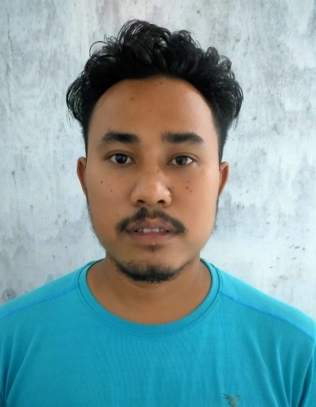
Name: Sachin Doley
Passing Year: 2019
Address: Vill: Namoni Tajik
P.O: Gogamukh, Dist.: Dhemaji
Email-id: sachindoley121@gmail.com
Contact No.:6002999512
Current Status: Preparing for Govt. Exam

