Slide 1
Name: Biswajit Borah
Passing Year: 2020
Address: Vill:
P.O:
Email-id:
Contact No.:
Current Status: Preparing for Govt. Exam

Slide 2
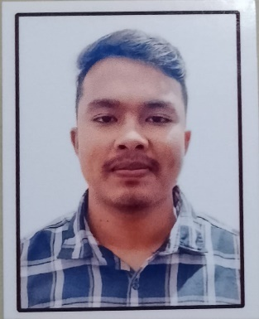
Name: Hirakjyoti Gogoi
Passing Year: 2022
Address:Vill: Khalihamari, P.O.: Khalihamari
Dist. Dhemaji, 787053
Email-id: babugogoi316@gmail.com
Contact No.: 9707671262
Current Status: Govt. Job under P.N.R.D,
Abhayapuri Div., Bongaigaon

