Slide 1
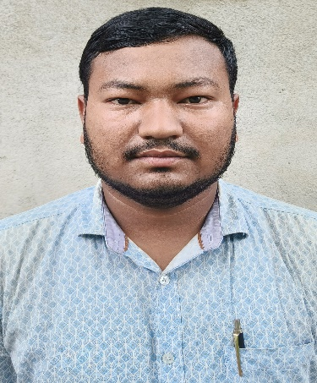
Name: Rahul Khanikar
Passing Year: 2020
Address: Vill: Napam
P.O: Bordoibam,
Dist.: Lakhimpur, 787053
Email-id: rahulkhanikar2018@gmail.com
Contact No.: 7002750348
Current Status: Senior HSO (Reliance Jio Pvt. Ltd)

Slide 2
Name: Hirakjyoti Gogoi
Passing Year: 2022
Address:Vill: Khalihamari, P.O.: Khalihamari
Dist. Dhemaji, 787053
Email-id: babugogoi316@gmail.com
Contact No.: 9707671262
Current Status: Govt. Job under P.N.R.D,
Abhayapuri Div., Bongaigaon

