Slide 1
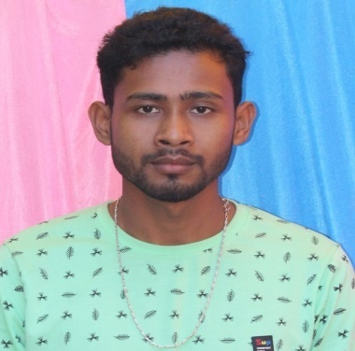
Name: Simanta Jyoti Bhuyan
Passing Year: 2020
Address: Vill: Lalukia
P.O: Gogamukh, Dist.: Dhemaji, 787034
Email-id: simantajyotibhuyan332@gmail.com
Contact No.: 6282351912
Current Status: HSO (Reliance Jio Pvt. Ltd)

Slide 2
Name: Hirakjyoti Gogoi
Passing Year: 2022
Address:Vill: Khalihamari, P.O.: Khalihamari
Dist. Dhemaji, 787053
Email-id: babugogoi316@gmail.com
Contact No.: 9707671262
Current Status: Govt. Job under P.N.R.D,
Abhayapuri Div., Bongaigaon

