Slide 1
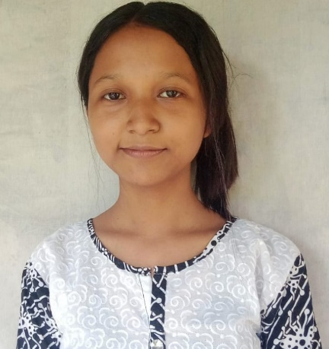
Name:Krishna Mili
Passing Year: 2021
Address: Vill: Kekuri kathal guri
P.O: Kekuri pomua muri
Email-id: milikrishna31@gmail.com
Contact No.: 8822414809
Current Status: Preparing for Govt. Exam

Slide 2
Name: Hirakjyoti Gogoi
Passing Year: 2022
Address:Vill: Khalihamari, P.O.: Khalihamari
Dist. Dhemaji, 787053
Email-id: babugogoi316@gmail.com
Contact No.: 9707671262
Current Status: Govt. Job under P.N.R.D,
Abhayapuri Div., Bongaigaon

