Slide 1
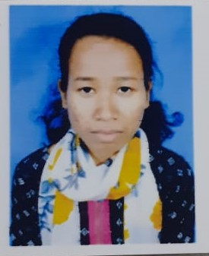
Name: Jaishri Dihingia
Passing Year: 2022
Address: Vill: Chinai-Gohain Gaon,
P.O: Ghilamara,
Dist.: Lakhimpur,
787053
Email-id: jaishridihingia@gmail.com
Contact No.:6002578932
Current Status:Preparing for Govt. Exam

Slide 2
Name: Hirakjyoti Gogoi
Passing Year: 2022
Address:Vill: Khalihamari, P.O.: Khalihamari
Dist. Dhemaji, 787053
Email-id: babugogoi316@gmail.com
Contact No.: 9707671262
Current Status: Govt. Job under P.N.R.D,
Abhayapuri Div., Bongaigaon

