Slide 1
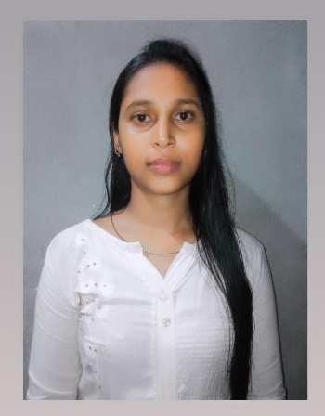
Name: Monjita Das
Passing Year: 2022
Address: Vill: Rupahi Gaon,
P.O: Ghilamara,
Dist.: Lakhimpur, 787053
Email-id: moondas184@gmail.com
Contact No.: 8099535640
Current Status: Own business

Slide 2
Name: Hirakjyoti Gogoi
Passing Year: 2022
Address:Vill: Khalihamari, P.O.: Khalihamari
Dist. Dhemaji, 787053
Email-id: babugogoi316@gmail.com
Contact No.: 9707671262
Current Status: Govt. Job under P.N.R.D,
Abhayapuri Div., Bongaigaon

