Slide 1
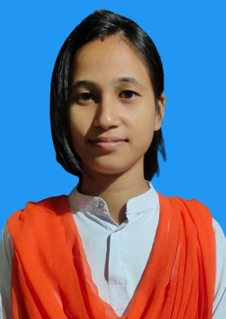
IYACHI GOGOI
Passing Year : 2022
Address : Moubal,
Lakhimpur, Assam - 787053
Phone Number : 6003667103 Email : iyachigogoi67@gmail.com
Current Status:

