Slide 1
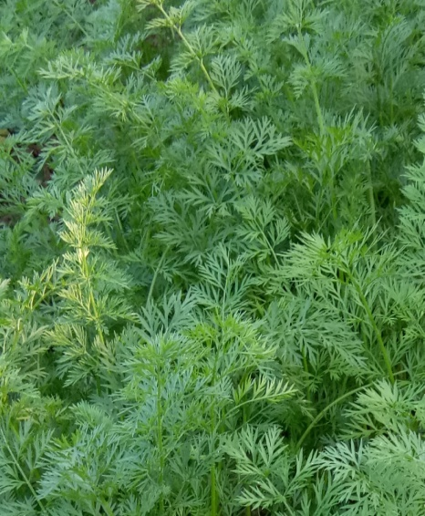
DR. S. M. BUJARBARUAH
Period From:
Feb, 2004 – Sept, 2004
Qualification: M.SC, M.PHILL,
PH.D, LLB,B.ED, B.MUSE
Add: Guwahati, Assam

