Slide 1
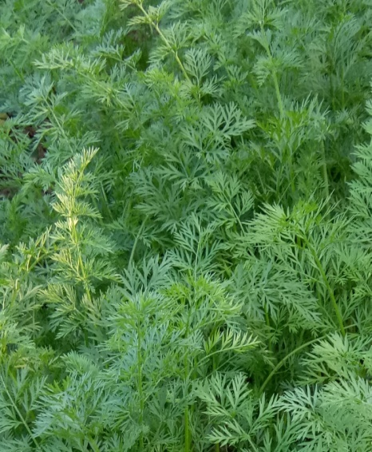
D.B GOGOI
Period From:
Oct, 1965 - March, 1967
Qualification: M.A
Add:

