Slide 1
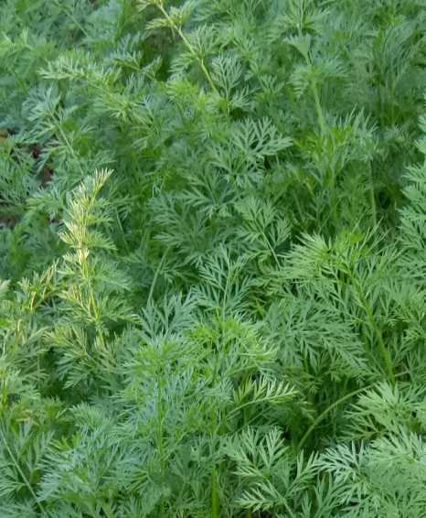
DEBESWAR PEGU, i/c
Period From:
Feb, 2004 – Sept, 2004
Qualification: M.A
Add:

