Slide 1
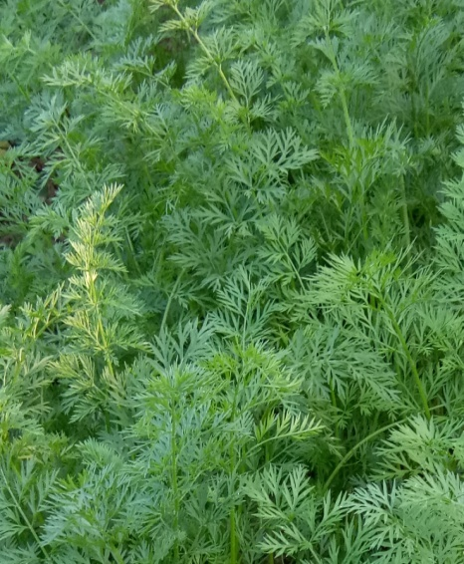
DIPALI BARUAH, i/c
Period From:
July, 2011 – Jan, 2012
Qualification: M.A
Add:

