Slide 1
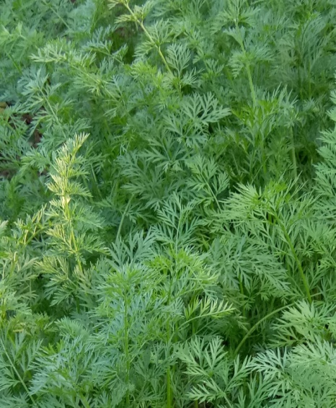
K. R. BARUAH
Period From:
April, 1967 – Oct, 2001
Qualification: M.A
Add:

