Slide 1
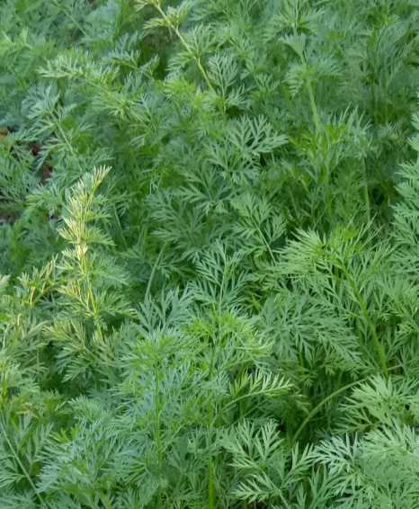
K.K. SINHA
Period From:
July,1962 - Sept. , 1963
Qualification: M.A
Add:

