Slide 1
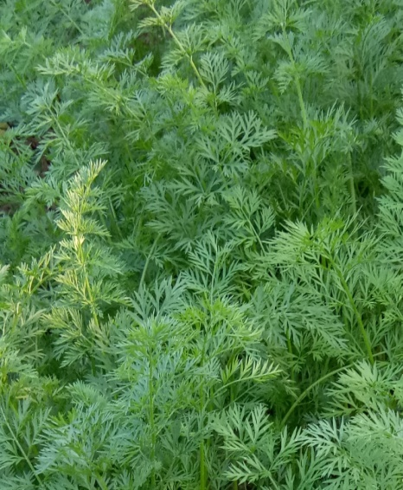
K. SARMAH, i/c
Period From:
Jan, 2002 – May, 2003
Qualification: M.A
Add:

